Slide 1
Email Update
May 2016

Slide 2
Department Update
Web & Digital Communications oversees email services
FY16 goal is to improve customer service related to emails
Assigned email supervision to one of our most customer service focused staff members
Hired new Email Specialist
Conducted user survey
Reviewed processes
Notes:
Web & Digital Communications now oversees email services and are dedicated to improving customer service
Introduce Crystal Ejanda, Associate Director of Web Services, and Christine Urban, Email Specialist

Slide 3
Internal Communication Channels
Emails: targeted to specific audience segments
E-newsletters
USF calendar emails (utilized for all events!)
myUSF announcements and events on dashboard
Digital Signage
Social Media
Notes:
As a reminder, in addition to email we have a number of other internal communication channels

Slide 4
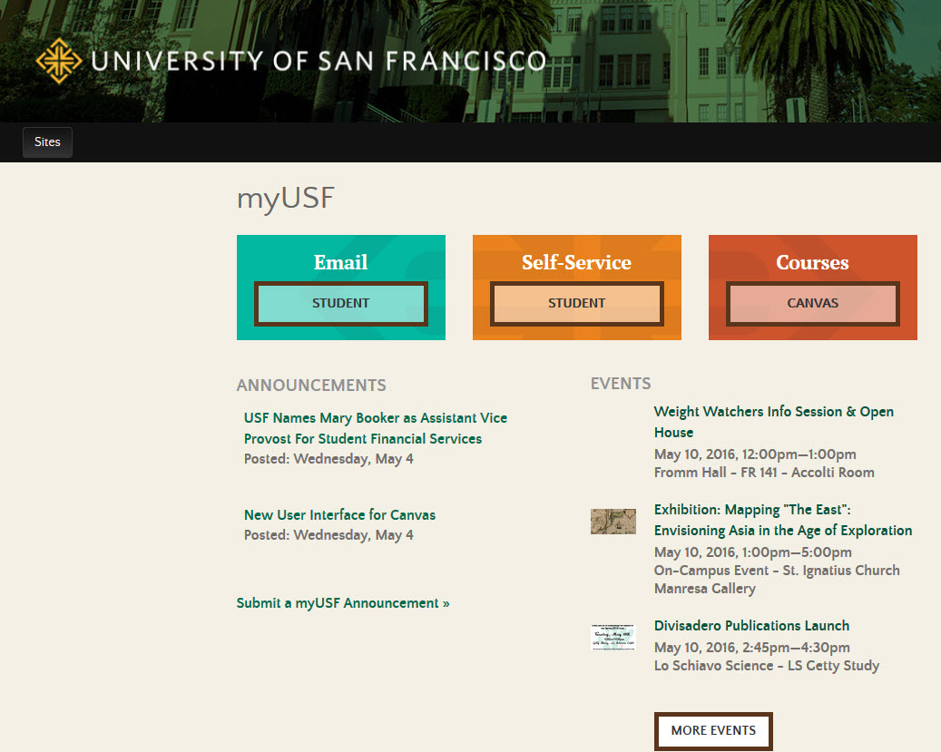
Notes:
This is how announcements and events are dispalyed in myUSF on your dashboard. Dashboards are currently customized for students, faculty, and staff. Currently eCommunications is selecting emails to show up on the announcements page. Anyone can ask us to list an announcement by clicking on the link from the dashboard under “announcements” or sending an email to ecommunications@usfca.edu. We have a dedicated staff member setting up announcements.
Upcoming enhancements:
- fall project is to have dashboards segmented further that will be specific for each school and then for undergraduate or graduate students.
- announcement listing will be enhanced to show a summary snippet for each announcement

Slide 5
Email Goals
Ensure students, faculty, and staff receive messages important to them
Improve open rates overall and increase attention to required messages
Issue:
Email seems to be the preferred sender’s delivery method, but not necessarily how audiences wants to consume information. How do we balance this?

Slide 6
Email Stats
iModules | 2014 | 2015
Total Emails Sent | 7,749,386 | 8,405,518
Total Email Campaigns | 2,085 | 2,041
Email Open Rate | 33.00% | 34.00%
Sampling of number of emails received in 2015
Student averaged 9 per week
Staff averaged 10 per week
Progress has been made in reducing the average email per person, but overall volume is still too high
Notes:
From 2014 to 2015, only reduced number of emails by 44. Busy weeks we send 80-90 emails per week.

Slide 7
February 2016 Communication Preferences Survey
1952 responses
49% of students receive too many emails (46% of all respondents)
64% of students would prefer one weekly event email (62% of all respondents)
64% of students would prefer "optional reading" emails as myUSF announcements (62% of all respondents)
Student | 1,483 | 76%
Faculty | 169 | 9%
Staff | 300 | 15%
Total | 1,952 | 100%
Notes:
Bottom # includes all respondents of survey (student, faculty, and staff)

Slide 8
Student Comments from Survey
The ton of emails are not as much a hassle as much as they take away my incentive to look through them. They are so many I tend to ignore them and not truly pay attention to the ones that matter.
Make sure that emails that are sent out are important enough for each student to receive, as we receive a lot of emails a day for other things as well.
Yes you send me way too many emails. That's my answer to your survey.

Slide 9
Q: Student Required Reading Categories & Preferred Delivery Method
# | Category | Email | Announcements | Should not be "required" | Total
1 | Academic Requirements | 1,353 | 248 | 7 | 1,682
2 | Billing/Tuition | 1,377 | 207 | 2 | 1,636
3 | Financial Aid | 1,330 | 237 | 17 | 1,651
4 | Health Requirements | 1,297 | 269 | 24 | 1,674
5 | Registration Requirements | 1,368 | 256 | 4 | 1,711
* Data shows students agree and want required reading emails
Notes:
On a great note, students want and desire required reading messages!

Slide 10
Q: Student Optional Reading Categories & Preferred Delivery Method
# | Category | Email | Announcements | Do not wish to receive | Total
1 | Office Closures | 793 | 464 | 242 | 1,668
2 | Parking Lot Closures | 590 | 448 | 441 | 1,640
3 | Student Leadership Opportunities | 768 | 458 | 267 | 1,688
4 | Student Senate | 511 | 431 | 458 | 1,629
* Data shows students are more varied in their preferences on how to receive optional reading messages

Slide 11
Email Process
Email request received
Initial review to ensure all information is provided
Email set up in iModules
Sometimes pre-built emails still need formatting/code clean-up and image optimization
Sometimes, imagery needs to be sourced and optimized
Copy editor reviews for alt text, dates, broken links, USF style, etc.
List set up (may need to request from Development or CIPE)
Edits received back from copy editor
Edits implemented and new draft is highlighted and forwarded
Potentially more changes made to email and/or list
After client approves, email is released

Slide 12
What’s Working
E-newsletters
USF monthly e-newsletter average open rate: 43%
Overall recurring e-newsletters open rate: 25%
Semi-weekly calendar emails
Calendar email open rate: 43%
Standard templates
Copyediting services
Notes:
Higher Ed Industry Standards for Open Rates: 22% Higher Ed, 18% for Marketing/Advertising
Standard templates – display, brand trust; started rolling out new ones
Copyediting: increased accuracy and quality; Arvin Temkar was hired last May and he has been providing email copyediting service for about a year now

Slide 13
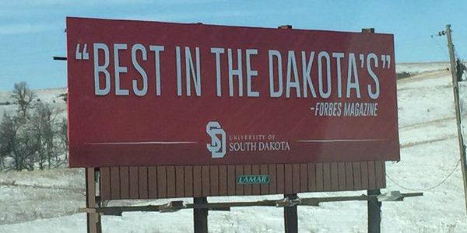
A Glimpse into Copyediting
Notes:
What’s wrong with this picture? Explain importance of copyediting and the copyediting process

Slide 14
A Glimpse into Copyediting
Example: The Serial/Oxford Comma
Incorrect: I love my parents, Lady Gaga and Robin Hood.
Correct: I love my parents, Lady Gaga, and Robin Hood.
Example: Capitalizations
Incorrect: The President of the University will speak on Important Topics at a City meeting on Tuesday.
Correct: Fr. Paul Fitzgerald, S.J., is the president of the University of San Francisco, the city’s oldest university.
Editorial Style Guide: myusf.usfca.edu/marketing-communications/editorial-style-guide Email Style Guide: myusf.usfca.edu/marketing-communications/email-style-guide

Slide 15
What Needs Improvement
Adherence to timelines
3 business days for pre-built email, 5 business days if needs to be set up
In the fall, 1/3 of all requests were “exceptions”
E-newsletters
Better timing in release of e-newsletters to same audience
Turnaround time: 3-5 business days
Opt-in process is very manual
iModules has an opt-out "all" option; people opt-out of required messages and we must manually re-opt-in people
Notes:
Opt-in: CANN-Spam laws, required to have global opt-out, but there are messages that are required (e.g., CLERY)

Slide 16
Email Process Changes
Emergency or urgent outage messages affecting the whole USF community will be streamlined
Plain text email with simplified language
Use a custom subject line: USF System Outage/Alert
Message would be released same day
Notes:
Reduces need for copy editing/errors
Reduce hours spent custom creating emails and set up
Greatly reduce turn-around time

Slide 17
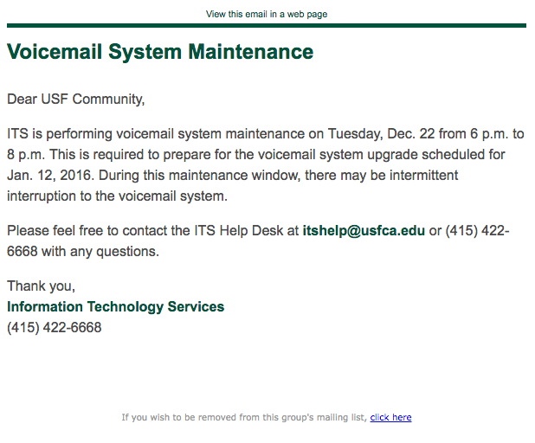
Outage Email Template Example
**********PROVIDE A SAMPLE**************
Subject: Voicemail System Maintenance
Dear USF Community,
ITS is performing voicemail system maintenance on Tuesday, Dec. 22 from 6 p.m. to 8 p.m. This is required to prepare for the voicemail system upgrade scheduled for Jan. 12, 2016. During this maintenance window, there may be intermittent interruption to the voicemail system. Please feel free to contact the ITS Help Desk at itshelp@usfca.edu or (415) 422-6668 with any questions.

Slide 18
Email Process Changes
“Optional reading” emails will be posted as announcements in myUSF
UNIVERSITY-WIDE
Office Closures
Parking Lot Closures Aggregate office closures and send out during peak closure seasons
STUDENT SPECIFIC
Student Leadership Opportunities
Student Senate (already included in e-newsletters)
FACULTY/STAFF SPECIFIC
Grant/Award Achievements
Grant/Award Opportunities
Monthly message about Grant Awards and include in e-newsletters
Notes:
Utilize myUSF dashboards and Schools, Student Life, and One Stop homepages to feature announcements
Instead of sending an email with 1 Grant Award recipient, we will consolidate and send out monthly

Slide 19
Email Process Changes
Send out one weekly calendar email on Tuesdays
64% of students prefer to receive event information in one weekly email
Death announcements–limit the emails that go to the whole university
It seems like every day we receive an email about someone passing away or about grants or awards. I realize that this is probably very important information to certain parties, but perhaps not the entire campus.
Notes:
Death Announcements will still be sent out by email but not to the whole university. We will post announcements to all of the USF community, but emails will be more targeted to those affected & should be for current members of the USF community.

Slide 20
Email Process Changes
Create more efficiency around copyediting process for emails and e-newsletters. Copy editing provided for these audiences:
External audience
Entire USF Community
Message from President or Provost
All students
500+ people
Required reading
Notes:
Refer to the style guide and you are empowered to copyedit for all other emails

Slide 21
Email Process Changes
New responsive template with branding that matches marketing website
Clearer subject lines, e.g., USF Required or USF Action Required
Update opt-out messaging in iModules and add message to the footer of "required" messages to discourage opting out

Slide 22
A Peak into iModules
Drafts and templates clean-up
New responsive template
Headers and footers
Resizing in iModules does not reduce file size
Standards: 72dpi, jpeg, ~40KB
Tools: Preview, Photoshop, MS Paint

Slide 23
Clarification on Email Lists
iModules can provide email lists for faculty, staff, and students
If data is not in iModules, may need to contact CIPE for custom list
Targeted alumni email lists need to be requested through Development Services, allow 2 weeks lead time
Any emails not in Banner will need to be provided by clients
Notes:
School, branch, fresh/soph/jr/senior
CIPE: eligible to walk seniors
Development: alumni in Orange County
Contacts at other schools inviting to symposium

Slide 24
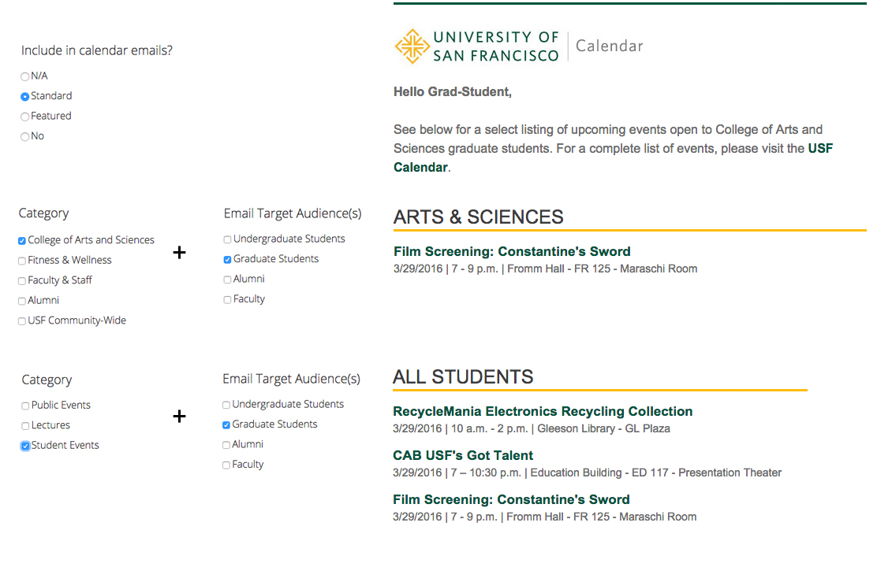
How to Display an Event in a Calendar Email
Notes:
You can feature your event in the USF calendar email. Make sure your event is tagged properly in Drupal. If you want an event to show up in the school section, check off the school name in the category and it will show up in the school section of the USF calendar email. Checking off “Student Events” will cause it to show up in the “All Students” section of the calendar email.
You can work with your calendar editor or school’s calendar manager to properly tag your event if you don’t have access.

Slide 25
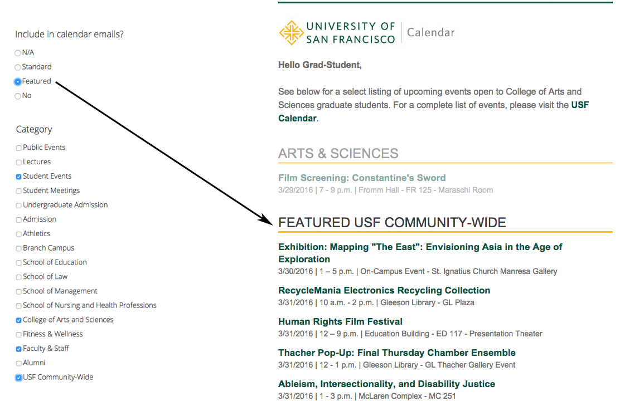
How to Feature an Event in a Calendar Email
Notes:
Selecting “Featured” under “include in calendar emails” will cause it an event to show up in the Featured USF Community-Wide section of the USF calendar email. You should only check this if the event appeals to wider USF community, has imagery, and event details. Work with calendar editors/school web manager if you don’t have access to update events, or you can send an email to ecommunications@usfca.edu.

Slide 26
Next Steps
Hold 2 in-person meetings for email administrators in May to communicate changes
Pilot process changes for summer and fall
Survey students and email administrators in mid-fall for feedback

Slide 27
Q&A
What questions do you have for us?
Contact us: ecommunications@usfca.edu

